Slide 1
Confident Completion Philippians 1:6 Athan Shongzan
Crossroads International Church
www.biblestudydownloads.com

Slide 2
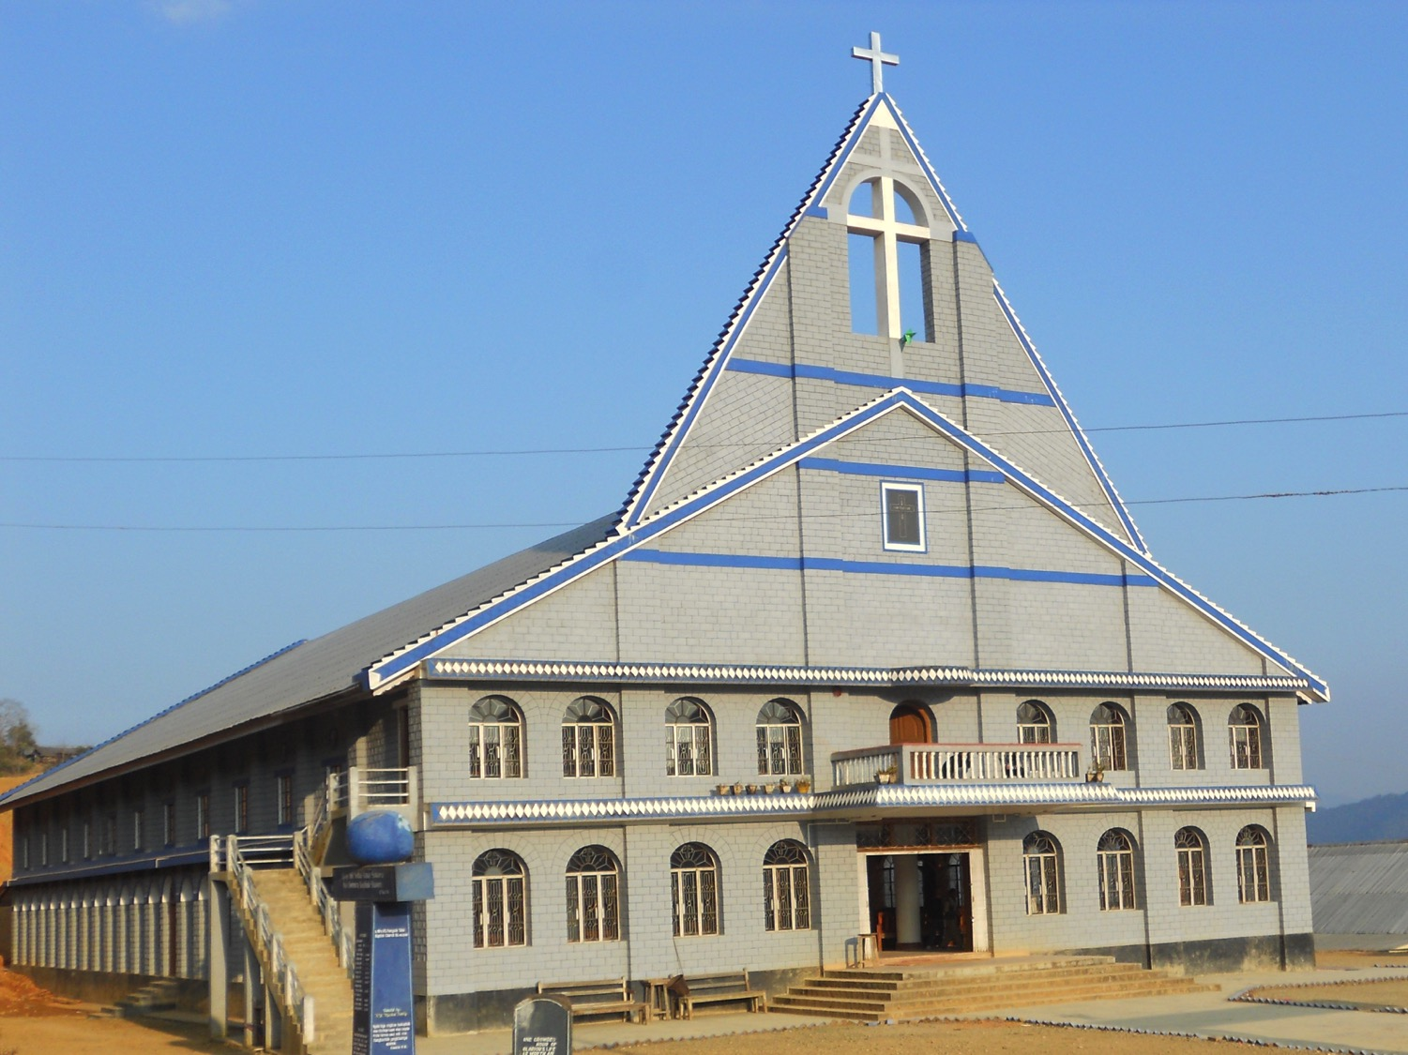
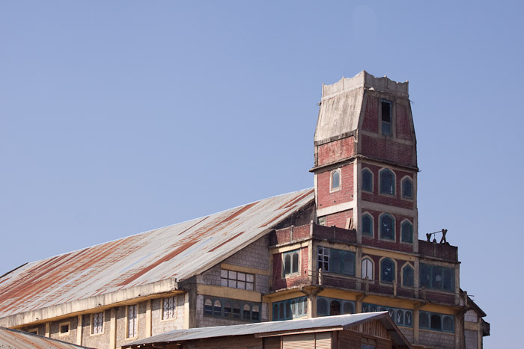

Slide 4
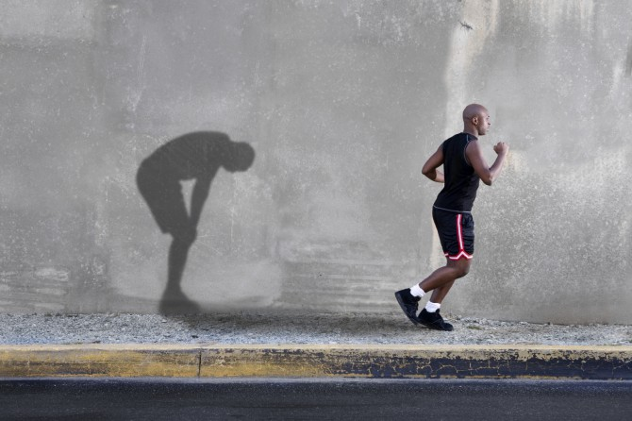

Slide 5
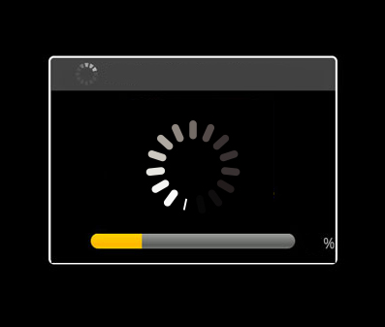

Slide 6
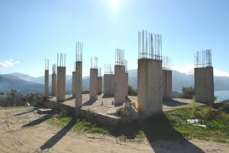

Slide 7
Confidence
Why should we live confidently in our Christian life?

Slide 8
Philippians 1:3-6 [NIV]
³I thank my God every time I remember you. ⁴In all my prayers for all of you, I always pray with joy, ⁵because of your partnership in the gospel from the first day until now, ⁶being confident of this, that he who began a good work in you will carry it on to completion until the day of Christ Jesus.

Slide 9
Philippians 1:6 [NLT]
⁶And I am certain that God, who began the good work within you, will continue his work until it is finally finished on the day when Christ Jesus returns.

Slide 10
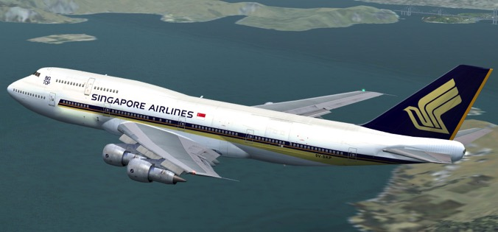
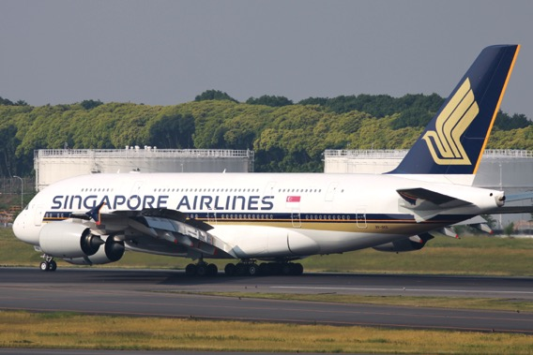
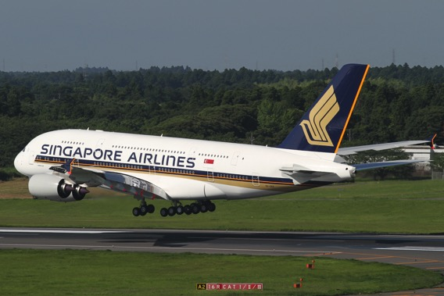
Being confident of this, that “he who takes off the aircraft will continue the flight until it is completely landed.”

Slide 11
Be confident in God!

Slide 12
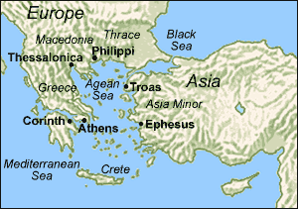
AD 50

Slide 13
Paul’s concerns
False teachers
Disunity

Slide 14
Philippians 1:6
Two reasons believers should be confident
I
II

Slide 15
I. God began the good work of salvation in you
A. God established the Philippian church
Acts 16:11-34

Slide 16
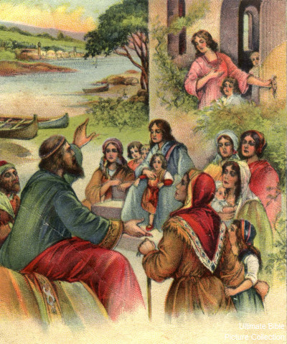
Acts 16:13-15

Slide 17
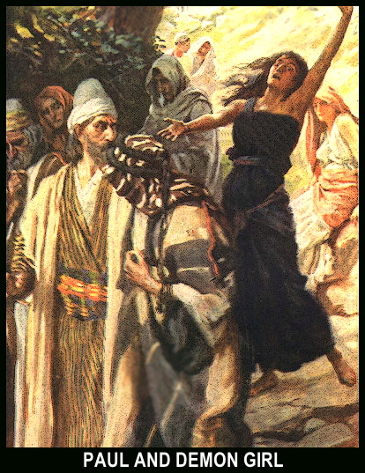
Paul and the Demon Possessed Girl Acts 16:16-18
Acts 16:16-18

Slide 18
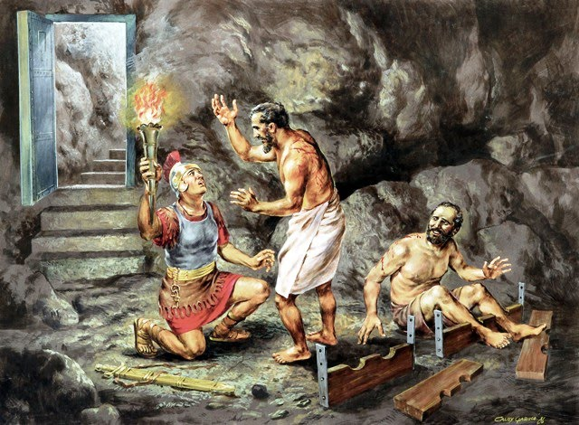
Acts 16:25-34

Slide 19
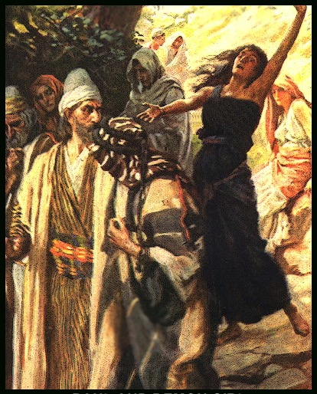
Three movements in Acts 16

Slide 20
A. God established the Philippian church
Saved by grace through faith

Slide 21
God built the church in his sovereign and unique way

Slide 22
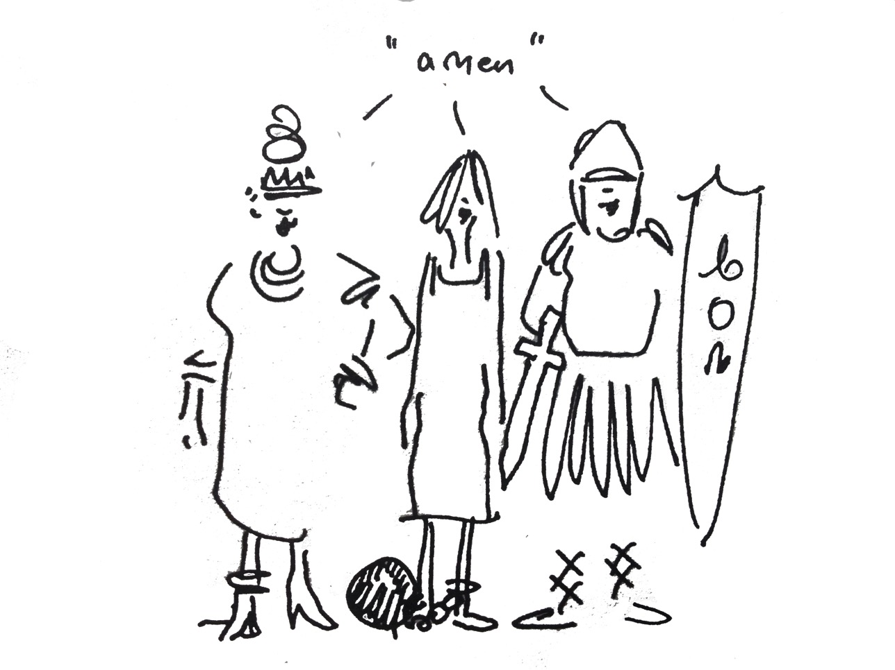
Three different nationalities Three different layers of society
Jewish Greek Roman
merchant slave middle class officer

Slide 23
B. God touched the believers to support the work of the gospel
“a good work”
Practical assistance, financial giving
Partnership = “sharing” of resources

Slide 24
B. God touched the believers to support the work of the gospel
Financially supporting Paul (4:15-16)
Helped the needy in Jerusalem (2 Cor. 8:1-4)
Personal help (4:10)

Slide 25
C. Who enables believers to give to God’s mission?

Slide 26
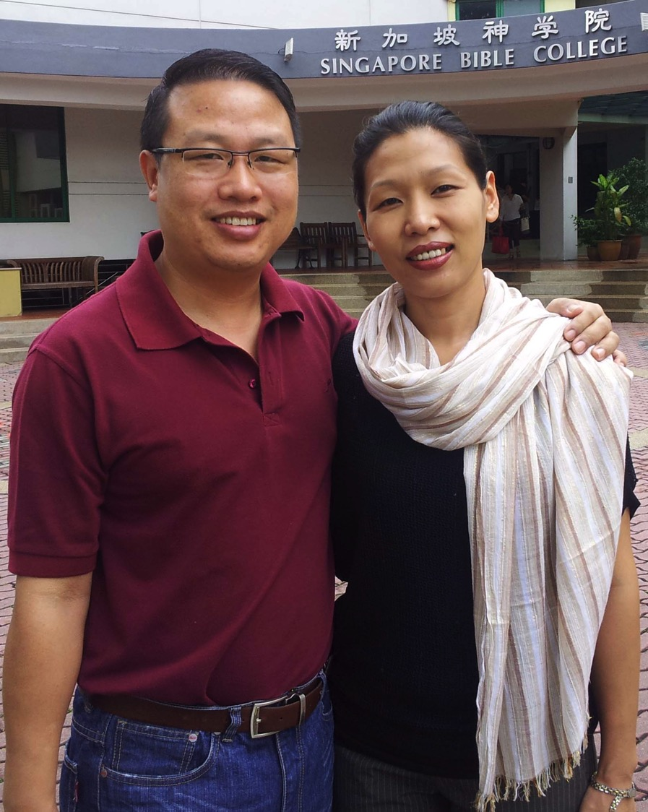

Slide 27
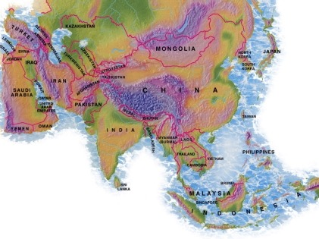
Crossroads Missions Funds 2014
MONGOLIA
BANGLADESH
PAKISTAN
NEPAL
MYANMAR
INDIA
10-40 Window
THAILAND
INDONESIA
SINGAPORE
Notes:
CIC regularly supports cross-cultural missionaries in Thailand, Myanmar, and a family headed to Indonesia. Semi-regular gifts go to Pakistan, India, Bangladesh, Nepal and Mongolia.

Slide 29
Be confident because it is God who began the good work in you

Slide 30
Will God ever stop this work in us?

Slide 31
Philippians 1:6
Two reasons why believers should be confident
I
II

Slide 32
II. God will complete the good work of salvation in you
A. God will continue his work until Jesus returns

Slide 33
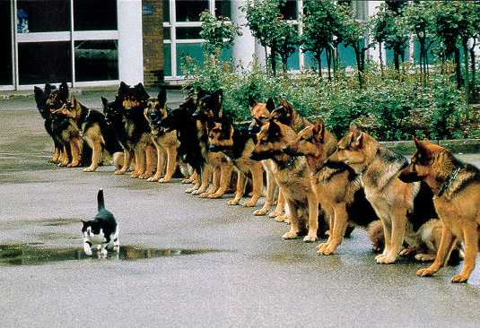
Continue even in the face of false teaching and disunity

Slide 34
Philippians 3:2 [NLT]
“Watch out for those dogs, those people who do evil, those mutilators who say you must be circumcised to be saved.”

Slide 35
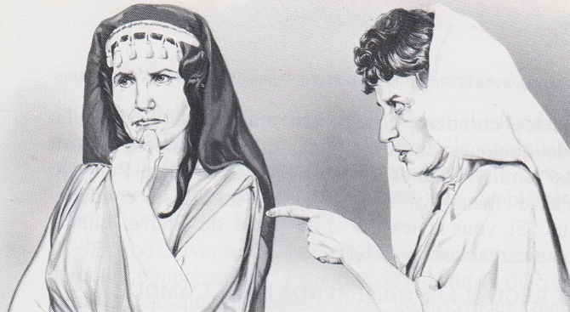
Philippians 4:2-3

Slide 36
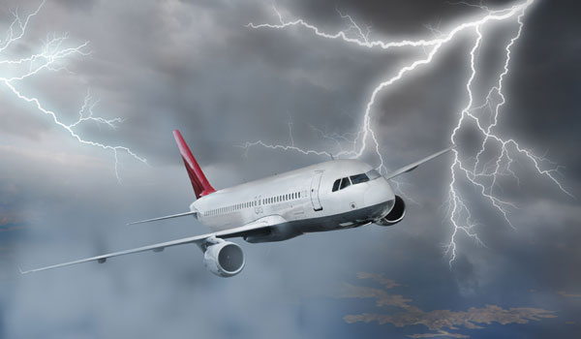
What challenges do you have?
Temptation
False teaching
Confusion
legalism
Disunity

Slide 37
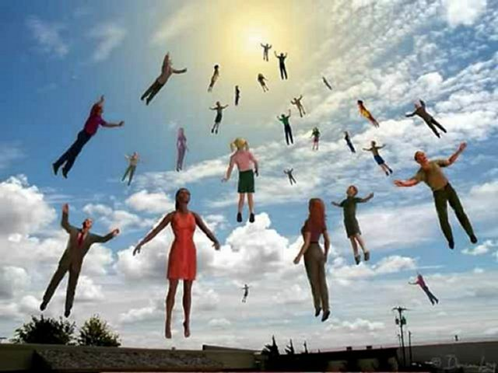
“The Day of Christ Jesus”
Consummated, glorified, rewarded

Slide 38
Christ’s return is the hope that will keep us confident
Hope for the future, confidence for today

Slide 39
I won’t give up on you!

Slide 40
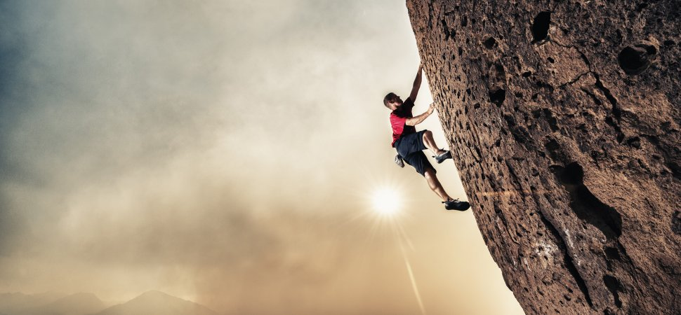
Live by faith
in God’s assured future for you
Will I ever complete my studies in SBC?

Slide 41
I. God began the good work of salvation in you
II. God will complete the good work of salvation in you

Slide 42
Be confident, for it is God who begins and completes the good work in you. [Main Idea]

Slide 43
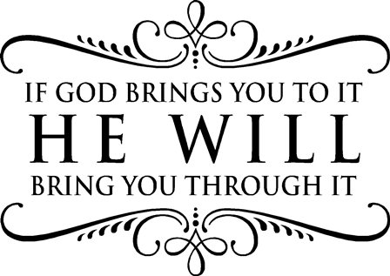

Slide 44
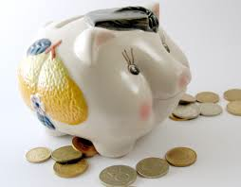
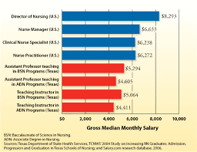
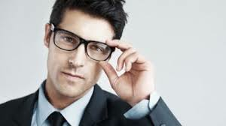
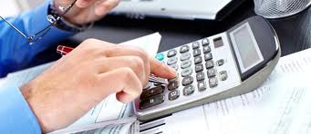
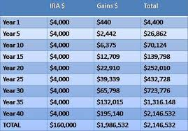
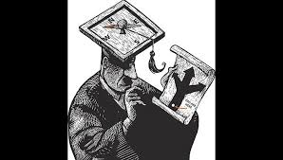
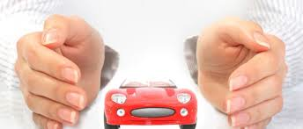

Slide 45
Where is your confidence?
Philippians 3:4-8
⁴if others have reason for confidence in their own efforts, I have even more! ⁵I was circumcised when I was eight days old. I am a pure-blooded citizen of Israel and a member of the tribe of Benjamin—a real Hebrew if there ever was one! I was a member of the Pharisees, who demand the strictest obedience to the Jewish law. ⁶I was so zealous that I harshly persecuted the church. And as for righteousness, I obeyed the law without fault. ⁷I once thought these things were valuable, but now I consider them worthless because of what Christ has done. ⁸Yes, everything else is worthless when compared with the infinite value of knowing Christ Jesus my Lord. For his sake I have discarded everything else, counting it all as garbage, so that I could gain Christ.

Slide 46
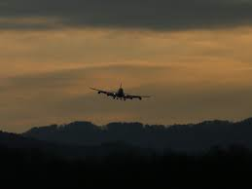
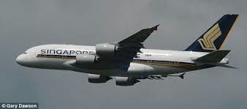
Do you know the pilot of your life?

Slide 47
Think of a good work that God has begun in your life
Be confident.
God began it.
He will complete it.

Slide 48
Black

Slide 49
NT Sermons link at biblestudydownloads.com
Get this presentation for free!

